Slide 1
Software Design and Analysis
Logical Models: Interaction Models
Sequence Diagram
Department of Computer Science
FAST-NUCES, CFD Campus

Slide 2
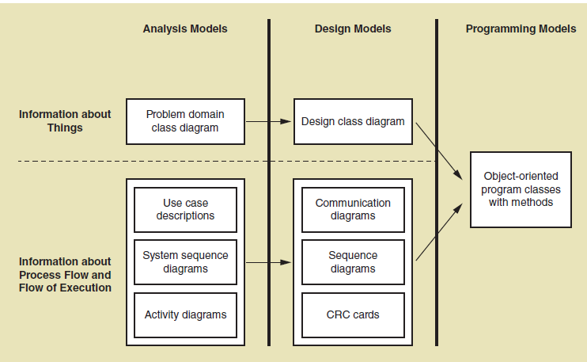

Slide 3
Interaction Diagram Fundamentals
Why we need interaction diagrams?
  Illustrate how user interacts with system.
  Illustrate how objects interacts with each other.
  Emphasizes time ordering of messages.
There are two types of interaction diagrams:
  sequence diagram
  communication diagram (called collaboration diagram in UML 1.4 ).
Can model simple sequential flow, branching, iteration (loop) , …etc
The two diagrams are equivalent in terms of semantics

Slide 4
Key parts of a sequence diag.
participant: an object or entity that acts in the sequence diagram
  sequence diagram starts with an unattached "found message" arrow
message: communication between participant objects
the axes in a sequence diagram:
  horizontal: which object/participant is acting
  vertical: time (down -> forward in time)

Slide 5
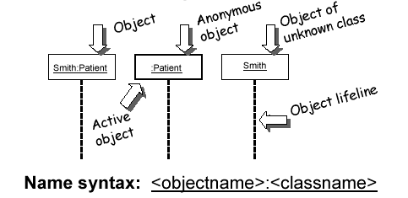
Representing objects
Squares with object type, optionally preceded by object name and colon
  write object's name if it clarifies the diagram
  object's "life line" represented by dashed vert. line

Slide 6
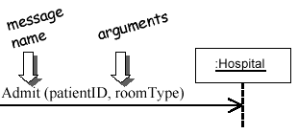
Messages between objects
message (method call) indicated by horizontal arrow to other object
  write message name and arguments above arrow

Slide 7
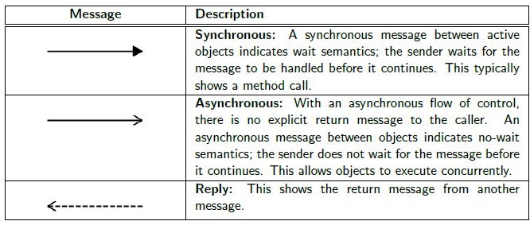
Messages, continued
message (method call) indicated by horizontal arrow to other object
  dashed arrow back indicates return
  different arrowheads for normal / concurrent (asynchronous) methods

Slide 8
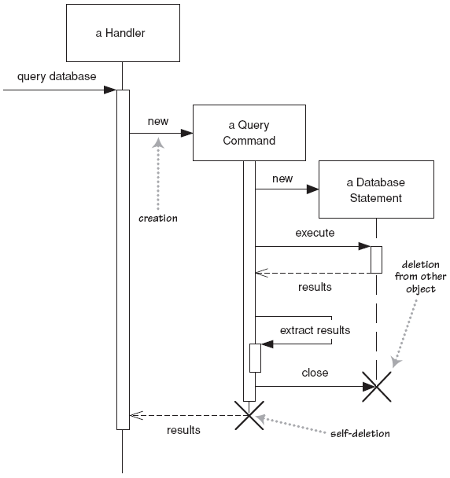
Lifetime of objects
creation: arrow with 'new' written above it
  notice that an object created after the start of the scenario appears lower than the others
deletion: an X at bottom of object's lifeline
  Java doesn't explicitly delete objects; they fall out of scope and are garbage-collected

Slide 9
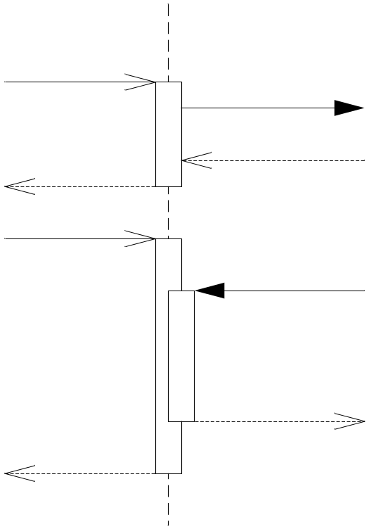
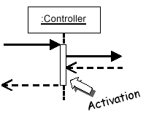
Indicating method calls
activation: thick box over object's life line; drawn when object's method is on the stack
  either that object is running its code, or it is on the stack waiting for another object's method to finish
  nest to indicate recursion
Activation
Nesting

Slide 10
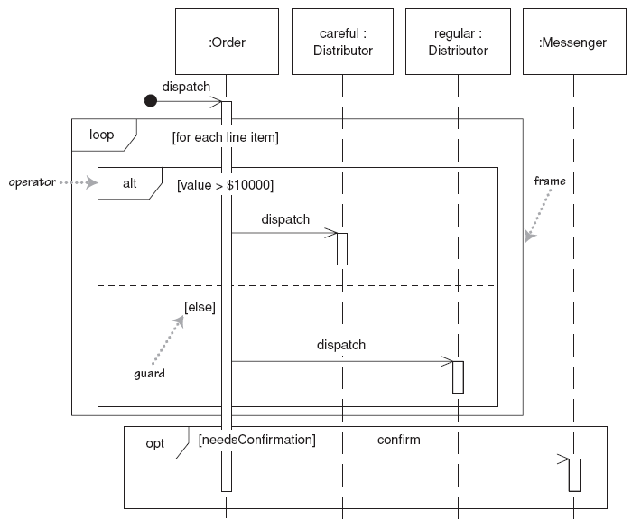
Indicating selection and loops
frame: box around part of a sequence diagram to indicate selection or loop
  if -> (opt) [condition]
  if/else -> (alt) [condition], separated by horizontal dashed line
  loop -> (loop) [condition or items to loop over]

Slide 11
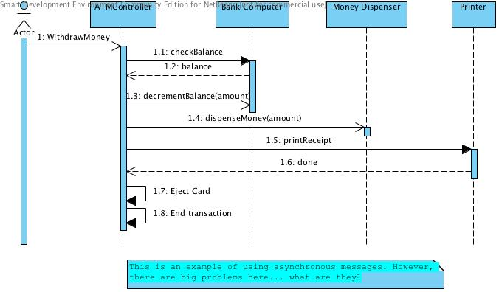
Example

Slide 12
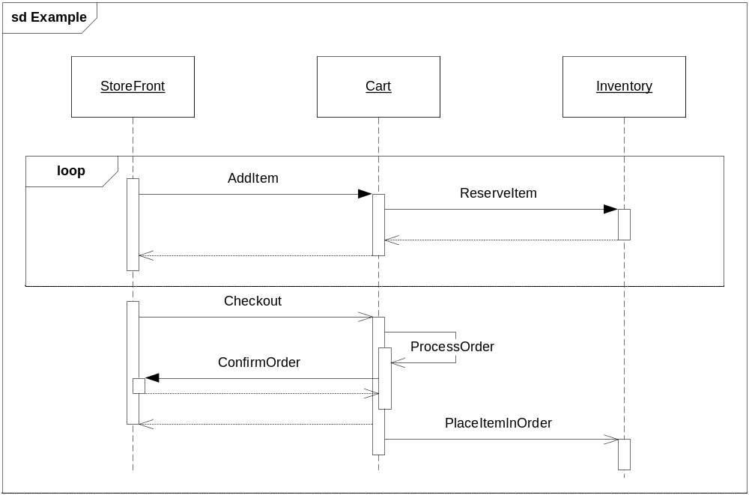
Example: 2
There are problems here. What are they?

Slide 13
Summary
Sequence diagrams model object interactions with an emphasis on time ordering
Method call lines
  Must be horizontal!
  Vertical height matters! “Lower equals Later”
  Label the lines
Lifeline – dotted vertical line
Execution bar – bar around lifeline when code is running
Arrows
  Synchronous call (you’re waiting for a return value) – triangle arrow-head
  Asynchronous call (not waiting for a return) – open arrow-head
  Return call – dashed line

Slide 14
Sequence diagram exercise 1
Let's do a sequence diagram for the following casual use case, Start New Poker Round :
The scenario begins when the player chooses to start a new round in the UI. The UI asks whether any new players want to join the round; if so, the new players are added using the UI.
All players' hands are emptied into the deck, which is then shuffled. The player left of the dealer supplies an ante bet of the proper amount. Next each player is dealt a hand of two cards from the deck in a round-robin fashion; one card to each player, then the secon card.
If the player left of the dealer doesn't have enough money to ante, he/she is removed from the game, and the next player supplies the ante. If that player also cannot afford the ante, this cycle continues until such a player is found or all players are removed.

Slide 15
Sequence diagram exercise 2
Let's do a sequence diagram for the following casual use case, Add Calendar Appointment :
  The scenario begins when the user chooses to add a new appointment in the UI. The UI notices which part of the calendar is active and pops up an Add Appointment window for that date and time.
  The user enters the necessary information about the appointment's name, location, start and end times. The UI will prevent the user from entering an appointment that has invalid information, such as an empty name or negative duration. The calendar records the new appointment in the user's list of appointments. Any reminder selected by the user is added to the list of reminders.
  If the user already has an appointment at that time, the user is shown a warning message and asked to choose an available time or replace the previous appointment. If the user enters an appointment with the same name and duration as an existing group meeting, the calendar asks the user whether he/she intended to join that group meeting instead. If so, the user is added to that group meeting's list of participants.

Slide 16
In class exercise
Draw a sequence diagram for:
  In Beauty and the Beast kitchen items came to life. Draw a sequence diagram for making a peanut butter and jelly sandwich if the following objects are alive: knife, peanut butter jar (and peanut butter), jelly jar (and jelly), bread, plate. I may or may not want the crusts cut off. Don’t forget to open and close things like the jars, and put yourself away, cleanup, etc…

Slide 17
In class exercise
Draw a sequence diagram for:
  Returning a movie to Netflix. When you return it a person scan’s it in, the s/w detects that and then goes through a sequence of steps to get the new movie to you. Think of the different classes that would be involved: Queue, Shipping, Inventory, UserAccount, other classes??

Slide 18
In class exercise
Draw a sequence diagram for:
  Adding a picture to Flickr (or any online image database). Login, pick an album, upload a picture, etc… Think about the software classes that would be involved – WebGUI (think of this as reporting what the user does), UserAccount, Album, AlbumList, etc…
  Don’t forget to check and update their current disk usage. For this diagram show the check coming back as acceptable.. you would do a second diagram for them running over quota.

Slide 19
In class exercise
Draw a sequence diagram for:
  Getting on a flight. Start at home, check in at the counter, go through security, and end up at the gate. (If you have time during the exercise, get yourself to your seat.)
    You may get searched in security

